Slide 1
AI-Based Advanced Approaches and Dry Eye Disease Detection
Based on Multi-Source Evidence: Cases, Applications,
Issues, and Future Directions

Slide 2
Domain Introduction
Image processing is a fundamental field in computer science and engineering that deals with the analysis, manipulation, and interpretation of digital images.
It encompasses a wide range of techniques and algorithms used to perform various tasks, such as enhancing image quality, extracting features, recognizing patterns, and performing image-based decision making.
Image processing techniques can be applied in a wide range of domains, including computer vision, medical imaging, remote sensing, security and surveillance, and multimedia applications, among others.
The field of image processing is continuously evolving, with new algorithms and techniques being developed to address more complex and challenging problems.

Slide 3
Abstract
This study explores advanced AI-based methodologies for detecting dry eye disease through multi-source evidence, focusing on symptom prediction, disease classification, and eye blink detection.
We employ a Multi-Layer Perceptron (MLP) to predict dry eye disease based on symptomatic data, leveraging its capability to model complex, non-linear relationships.
Additionally, MobileNet is utilized to determine the presence of eye disease, offering a lightweight yet effective approach for real-time classification with reduced computational overhead.
To complement these methods, VGG-19 is applied for eye blink prediction, enhancing diagnostic accuracy by analyzing temporal features in eye movement patterns.
This integrated approach aims to improve the precision and efficiency of dry eye disease detection, addressing current challenges and paving the way for future advancements in ophthalmic AI applications.

Slide 4
Objectives
The main objective of our project is,
To predict the likelihood of dry eye disease based on symptomatic data collected from patients. The MLP model will utilize deep neural network architecture to capture complex, non-linear relationships within symptom data, enhancing the accuracy of disease prediction.
To determine the presence of eye disease by analyzing visual data using MobileNet, a lightweight convolutional neural network. MobileNet is designed for efficiency and effectiveness, making it suitable for real-time classification tasks in practical settings.

Slide 5
Introduction
Dry Eye Disease (DED) is a common and often debilitating condition characterized by a persistent sensation of dryness and irritation in the eyes, accompanied by various symptoms such as redness, burning, and blurred vision.
It results from an imbalance in the tear film, which can be caused by either reduced tear production or excessive tear evaporation.
The prevalence of DED has been rising globally due to increased exposure to environmental factors, such as air pollution and prolonged screen use, as well as an aging population.
DED can significantly impact an individual’s quality of life, affecting daily activities and overall well-being. The condition not only leads to discomfort but can also impair visual function and cause secondary complications like corneal damage and recurrent infections.

Slide 6
Existing system
In existing systems The OSDI is a patient-reported questionnaire designed to assess the frequency and severity of dry eye symptoms, as well as the impact of these symptoms on daily life.
While the OSDI provides useful subjective information, it is inherently limited by its reliance on patient self-reporting, which can introduce biases and inconsistencies.
Additionally, the questionnaire may not fully address the underlying pathophysiological mechanisms of dry eye disease, limiting its ability to guide precise treatment.
Machine Learning (ML) algorithms have begun to be explored as adjuncts or alternatives to traditional diagnostic methods.
Algorithms such as Support Vector Machines (SVM) and Random Forests have been used to classify dry eye disease based on features extracted from clinical data and patient-reported outcomes.

Slide 7
Disadvantages
Traditional tests such as Schirmer’s Test and Tear Break-Up Time (TBUT) can be influenced by patient factors and environmental conditions, leading to variability in results and potential inconsistencies in diagnosing dry eye disease.
Conventional methods like the Ocular Surface Disease Index (OSDI) primarily capture subjective symptoms and may not fully address the underlying pathophysiological mechanisms of dry eye disease, limiting their ability to provide a comprehensive diagnosis.
Early machine learning algorithms, such as Support Vector Machines (SVM) and Random Forests, can be complex to implement and tune.
SVMs require careful parameter adjustment and can be computationally intensive, while Random Forests may become less interpretable with numerous trees.
Many traditional diagnostic methods require specialized equipment and significant time for administration and analysis, which can limit their efficiency and accessibility in clinical settings.

Slide 8
Proposed system
The proposed system aims to enhance the detection and prediction of dry eye disease (DED) through a multi-faceted approach utilizing advanced machine learning models.
For symptom-based prediction, we employ a Multi-Layer Perceptron (MLP) to classify DED based on a CSV dataset of dry eye symptoms.
MLP will be used for classification, and performance will be evaluated using metrics including accuracy, precision, recall, and F1-score to determine whether the disease is affected. For visual diagnosis, MobileNet will be applied to images of eye diseases.
MobileNet will be trained and tested, and its effectiveness will be assessed based on accuracy and error rate in predicting the presence of eye disease.
Additionally, VGG-19 will be utilized to predict eye blinks using an eye blink dataset, involving similar preprocessing and feature extraction steps.

Slide 9
Advantages
The integration of MLP for symptom-based prediction, MobileNet for visual diagnosis, and VGG-19 for blink prediction provides a holistic approach to detecting and analyzing dry eye disease and related conditions.
By leveraging machine learning models, the system reduces the reliance on subjective assessments and patient self-reporting, leading to more consistent and objective diagnostic results.
Utilizing advanced models like MLP, MobileNet, and VGG-19 allows for sophisticated pattern recognition and classification, potentially improving the accuracy of detecting dry eye disease, eye disease presence, and eye blink patterns compared to traditional methods.
The use of automated machine learning models streamlines the diagnostic process, reducing the time required for analysis and enabling real-time or near-real-time assessments.
The system combines various types of data, including symptom records, imaging data, and blink patterns, to provide a more comprehensive evaluation of the condition, enhancing diagnostic precision.

Slide 10







Architecture diagram
Input Dataset (Images and CSV file)
Precompile Process
(Handling Missing values, Image Resize and Gray scale Conversions )
Data / Image Slicing
(Test and Train)
Feature Extraction
(Mean, Median and Variance, GLCM)
Performance Metrics
(Accuracy and Error Rate)
Classification
(MLP, VGG-19 and Mobile Net)
Prediction
(Affected or Not)

Slide 11
Flow diagram
Start Project
Data Collect and Precompile
Precompile
Precompile
Data Splitting
Image Splitting
Image Splitting
Classification
Feature Extraction (GLCM)
Feature Extraction (GLCM)
Algorithm (MobileNet)
Algorithm (VGG-19)
Model Generation
Affected by eye disease
Prediction
Yes
Yes
Prediction
Prediction
No
Not Affected
Blink Prediction
Not Affected
End Project

Slide 12
Use case Diagram
Dry Eye (csv)
Handling Missing Values & Label Encoding
Data Splitting
User
MLP
System
Performance Analysis
Eye Disease (Image)
Pre-compile
Feature Extraction
Mobile Net & VGG-19

Slide 13
Activity Diagram
Input Image
Dry Eye Disease
Eye Disease Prediction
Eye Blink Prediction
Pre-compiler
Data Splitting
GLCM
MobileNet
GLCM
VGG-19

Slide 14
ER Diagram
Image Resize
Display image
Pre-compile
Accuracy and error rate
Accuracy and error rate
Prediction
Algorithm
Feature extraction
GLCM
VGG-19
Streamlit UI
Image Splitting
Upload input
View
MobileNet
Dry Eye
Prediction
Eye Disease
Affected or Not
Eye Blink

Slide 15
Sequence Diagram
USER
DRY EYE
EYE DISEASE
EYE BLINK
4. GLCM
1. Input
6.VGG-19
2.Priliminary
5.MobileNet
7. Performance
3.MLP
Affected or not

Slide 16
Class Diagram
INPUT
Dry Eye ()
Eye Disease ()
Eye Blink ()
PRE COMPILE PROCESS
FEATURE EXTRACTION
CLASSIFICATION
PERFORMANCE
Image Resize ()
Splitting ()
MLP ()
Accuracy ()
Gray Scale Conversion ()
GLCM ()
VGG-19 ()
MobileNet ()
Error rate ()

Slide 17



DFD diagram – Level 0
Handling Missing values
Eye Disease Image
AI Based Dry Eye Disease Detection
Resize Image
PRE - RENDER
Gray scale Image
Dry Eye Disease
Eye Blink Image

Slide 18
DFD diagram – Level 1
Pre render
Label Encoding
Classification
Missing Values
Dry Eye Disease
Multi Layer Perceptron (MLP)
Test & Train Data

Slide 19
DFD diagram – Level 2
IMAGE SPLITTING
Train Image
Test Image
FEATURE EXTRACTION
GLCM
VGG-19
Eye Disease & Eye Blink
CLASSIFICATION
Pre Render
MobileNet
Accuracy,
Error rate
Comparison
PERFORMANCE ANALYSIS

Slide 20
System Requirements
HARDWARE REQUIREMENTS:
System : Pentium IV 2.4 GHz
Hard Disk : 200 GB
Ram : 4GB
SOFTWARE REQUIREMENTS:
O/S : Windows 10.
Language : Python
Front End : Streamlit Framework
Software used : Anaconda Navigator – Spyder IDE

Slide 21
Modules – Dry Eye Prediction
Input and Pre render
Data Splitting
Model Generation
Prediction
Result Generation

Slide 22
Modules description

Slide 23
Input and Preliminary process
The initial step involves selecting the Dry eye disease dataset from Kaggle, which is provided in a CSV file format. (https://www.kaggle.com/datasets/shankar24397/dry-eye-disease-in-medical-students)
Here we can fetch or read or load the collected data by using the pandas packages.
Data preprocessing is a crucial step to ensure the dataset is clean and ready for analysis.
Handling Missing Values: Missing values in the dataset can lead to inaccuracies in the analysis.
Methods such as imputation (replacing missing values with mean, median, or mode) or removal of records with missing values are employed to handle these gaps in the data.
Label Encoding: To convert categorical variables (such as gender and emotions) into numerical format, label encoding is used. This process assigns a unique integer to each category, enabling machine learning algorithms to process these variables effectively.

Slide 24
Data Splitting
During the machine learning process, data are needed so that learning can take place.
In addition to the data required for training, test data are needed to evaluate the performance of the algorithm in order to see how well it works.
In our process, we considered 70% of the input dataset to be the training data and the remaining 30% to be the testing data.
Data splitting is the act of partitioning available data into two portions, usually for cross-validator purposes.
One Portion of the data is used to develop a predictive model and the other to evaluate the model's performance.
Separating data into training and testing sets is an important part of evaluating data mining models.
Typically, when you separate a data set into a training set and testing set, most of the data is used for training, and a smaller portion of the data is used for testing.

Slide 25
Model Generation
A Multi-Layer Perceptron (MLP) is a type of artificial neural network used in machine learning and pattern recognition. It consists of multiple layers of nodes, including an input layer, one or more hidden layers, and an output layer. Each node, or neuron, in a layer is connected to every node in the subsequent layer, allowing the network to learn complex patterns through weighted connections.
1. Feedforward Structure: Data flows in one direction from the input layer through the hidden layers to the output layer, with no cycles or loops.
2. Activation Functions: Neurons in the hidden layers use activation functions (such as ReLU, sigmoid, or tanh) to introduce non-linearity, enabling the network to learn more complex relationships.
3. Backpropagation: MLPs use backpropagation to train the network by adjusting weights based on the error between the predicted and actual outputs, minimizing this error through optimization algorithms like gradient descent.

Slide 26
Prediction
Based on the model's analysis, it produces a prediction output.
This output is typically a binary classification indicating whether the individual is likely to be affected by dry eye disease or not.
In some models, it might also provide a probability score reflecting the likelihood of the disease.

Slide 27
Modules –Eye Disease & Eye Blink
Input and Pre render
Feature Extraction
Image splitting
Classification
Prediction
Result generation

Slide 28
Modules description

Slide 29
Input and Preliminary process
The dataset, Eye disease and eye blink dataset is implemented as input. The dataset is taken from dataset repository. The input dataset is in the format ‘.png, ‘.jpg.
Dataset Link: (https://github.com/MGD1K/MGD1k/tree/main )
In this step, we have to read or load the input image by using the imread () function.
The input image is used to detect or classify the affected or not.
In our process, we are used the tkinter file dialogue box for selecting the input image.
Eye disease images are sourced from Kaggle or similar repositories to ensure a diverse dataset encompassing various types and stages of Eye disease or Eye Blink. This step ensures that the dataset is representative and suitable for training and evaluation of the models.

Slide 30
Input and Preliminary process contd..
In our process, we have to resize the image and convert the image into gray scale.
To resize an image, you call the resize () method on it, passing in a two-integer tuple argument representing the width and height of the resized image.
The function doesn't modify the used image; it instead returns another Image with the new dimensions.
Convert an Image to Grayscale in Python Using the Conversion Formula and the matplotlib Library.
We can also convert an image to grayscale using the standard RGB to grayscale conversion formula that is imgGray = 0.2989 * R + 0.5870 * G + 0.1140 * B.

Slide 31
Feature Extraction
Mean, median, and variance are also commonly used in image processing to characterize the statistical properties of pixel values within an image. Here's how they are applied:
Mean: In image processing, the mean can be calculated across pixel values within a region of interest (ROI) or the entire image.
Median: The median is particularly useful for noise reduction in images.
Variance: Variance measures the variability or contrast in pixel values within an image.
GLCM computes the frequency of pixel pair occurrences at various spatial relationships within an image, providing insights into texture properties such as contrast, homogeneity, and entropy.

Slide 32
Classification
In our process, we have to implement the deep learning algorithm such as and VGG-19 and Mobile Net effectively.
VGG-19 is a deep convolutional neural network known for its simplicity and effectiveness in image classification tasks. It was developed by the Visual Geometry Group (VGG) at the University of Oxford.
MobileNet is designed for mobile and embedded vision applications, focusing on lightweight and efficient performance.
Its architecture is based on depthwise separable convolutions, which reduces computational cost and model size.

Slide 33
Prediction
In the prediction module, eye disease is classified using the MobileNet architecture, which efficiently handles the computational load with its depthwise separable convolutions, making it ideal for processing and classifying eye images in resource-constrained environments.
For detecting and analyzing eye blinks, the VGG-19 architecture is employed due to its deep convolutional layers and high accuracy in capturing intricate features from image datasets.
By leveraging MobileNet for eye disease classification and VGG-19 for eye blink detection, the system effectively combines efficiency and accuracy to deliver robust predictions for both tasks.

Slide 34
Result generation
The Final Result will get generated based on the overall classification and prediction. The performance of this proposed approach is evaluated using some measures like,
Accuracy
Accuracy of classifier refers to the ability of classifier. It predicts the class label correctly and the accuracy of the predictor refers to how well a given predictor can guess the value of predicted attribute for a new data.
AC= (TP+TN)/ (TP+TN+FP+FN)
TP – True Positive , TN – True Negative , FP – False Positive , FN – False Negative
Error Rate: Error rate, also known as classification error or misclassification rate, measures the frequency of incorrect predictions made by an algorithm compared to the ground truth.

Slide 35
Screenshots

Slide 36
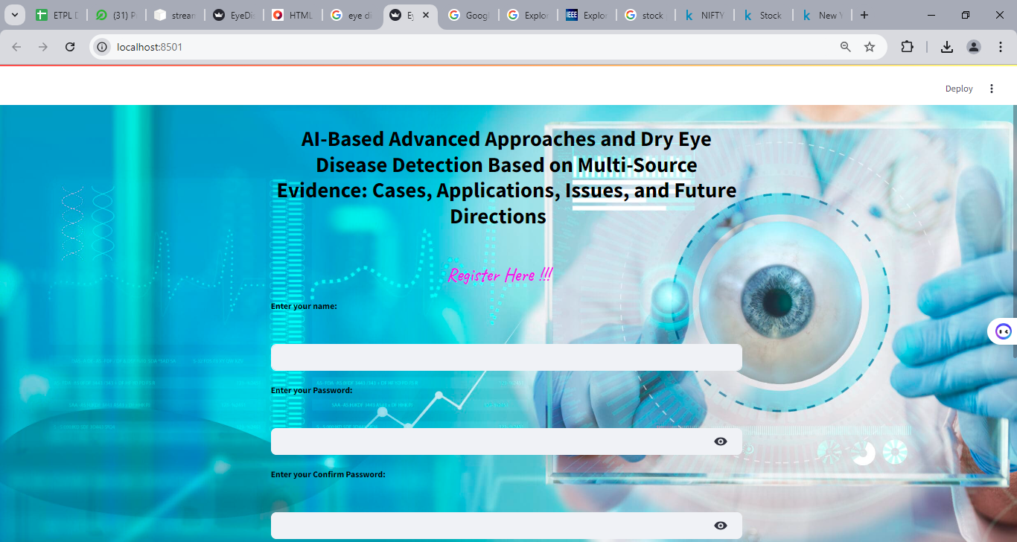

Register

Slide 37
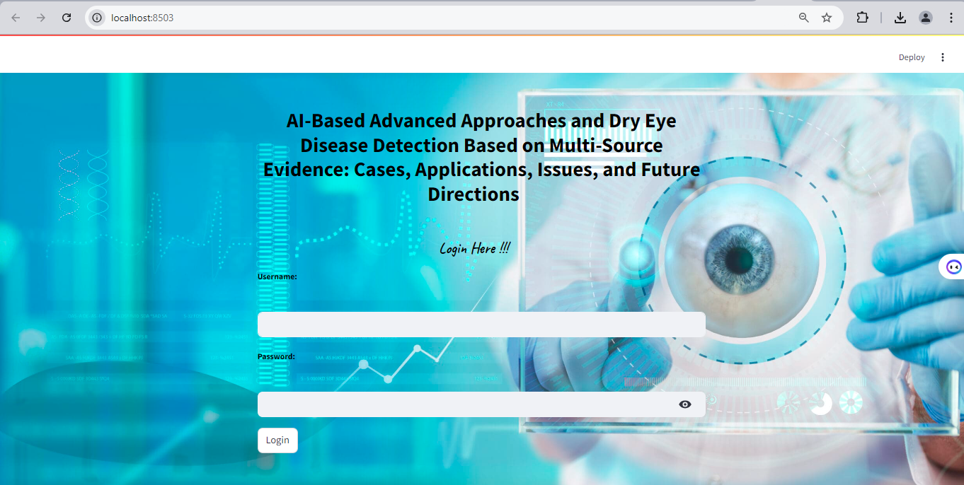
Login

Slide 38
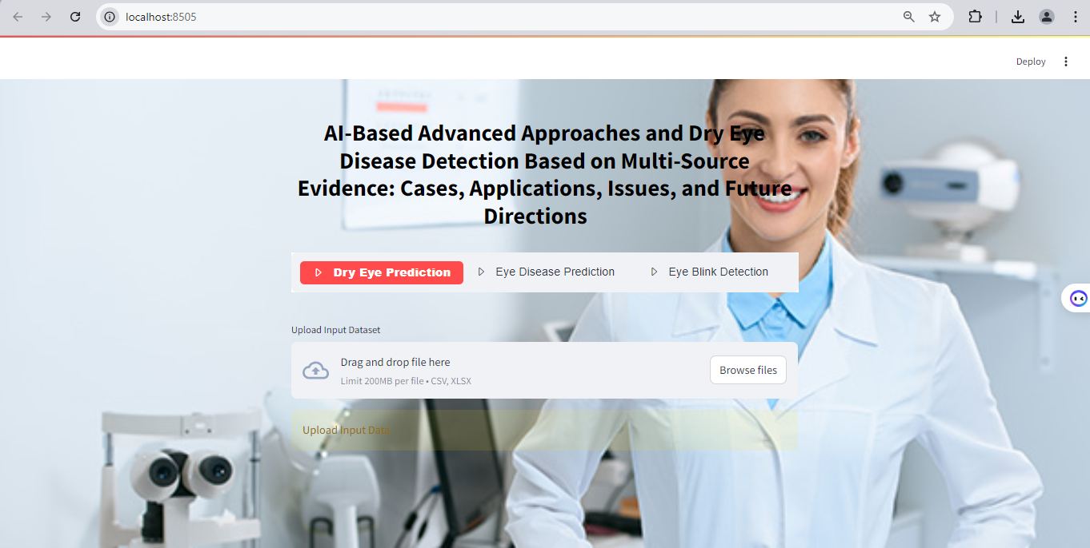
Prediction Page – Dry Eye Disease

Slide 39
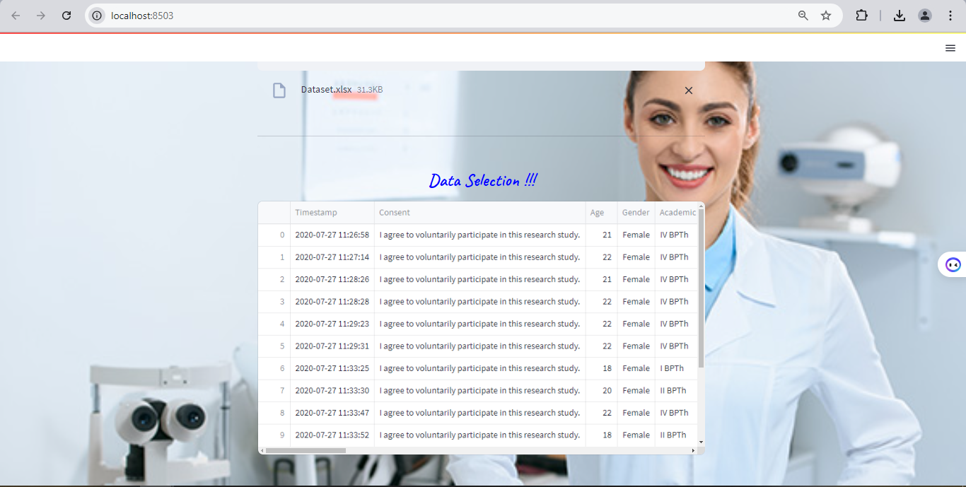
Data Selection

Slide 40


Preprocessing – Checking Missing Values

Slide 41


Preprocessing – Label Encoding

Slide 42

Data Splitting

Slide 43
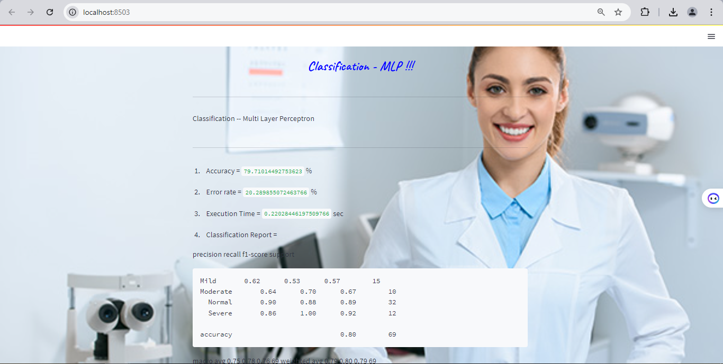
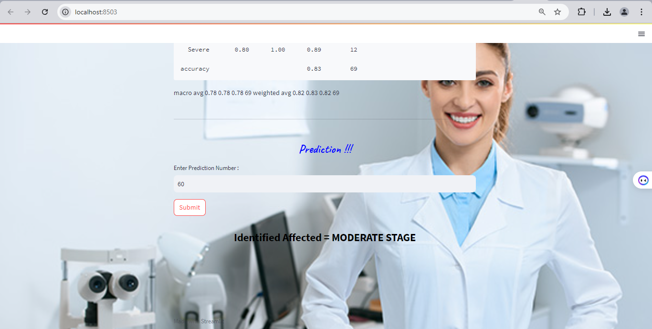
MLP & Prediction

Slide 44

Eye Disease Prediction – Upload Image

Slide 45
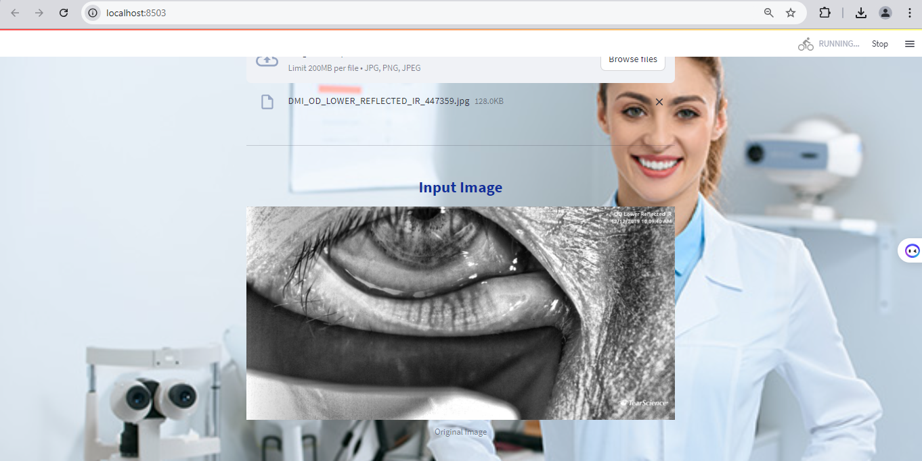
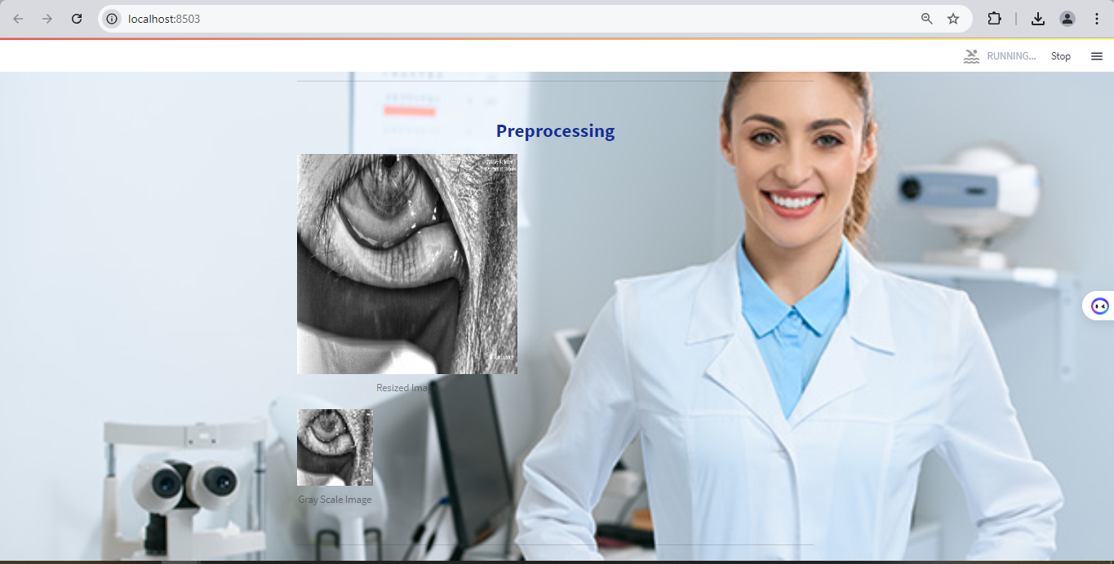
Input & Pre-render

Slide 46
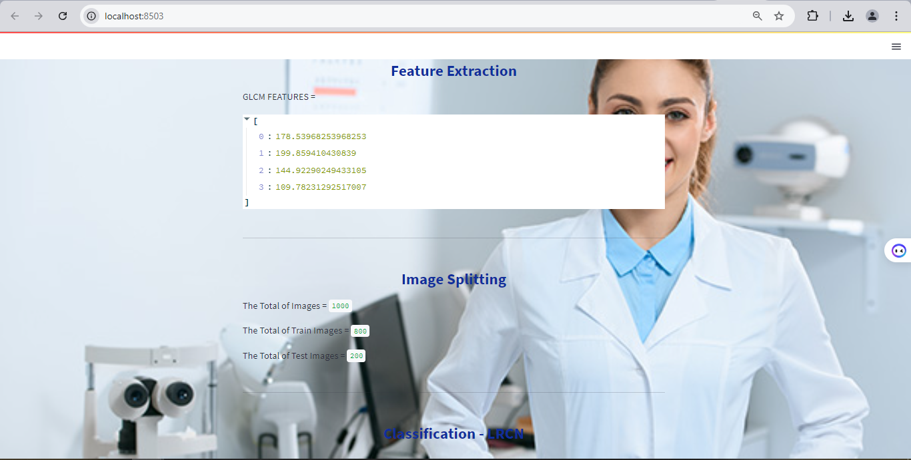
Feature extraction & Image Splitting

Slide 47
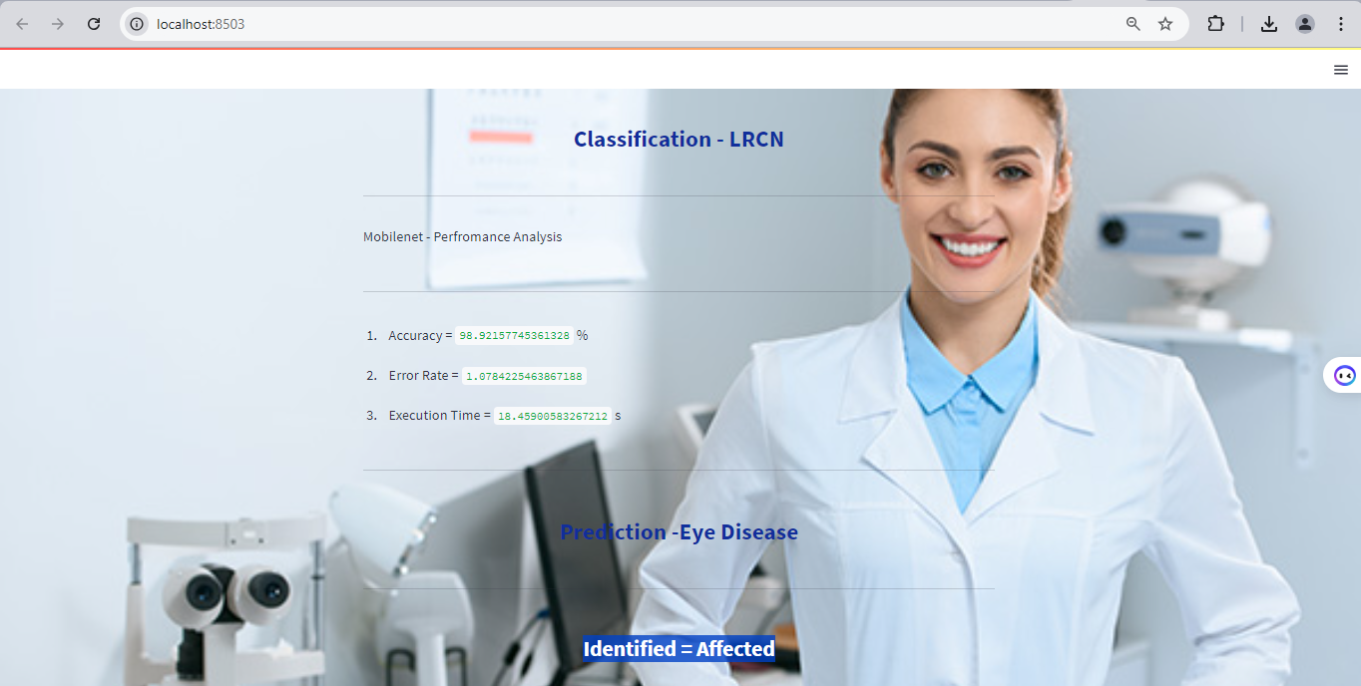
Classification & Prediction

Slide 48
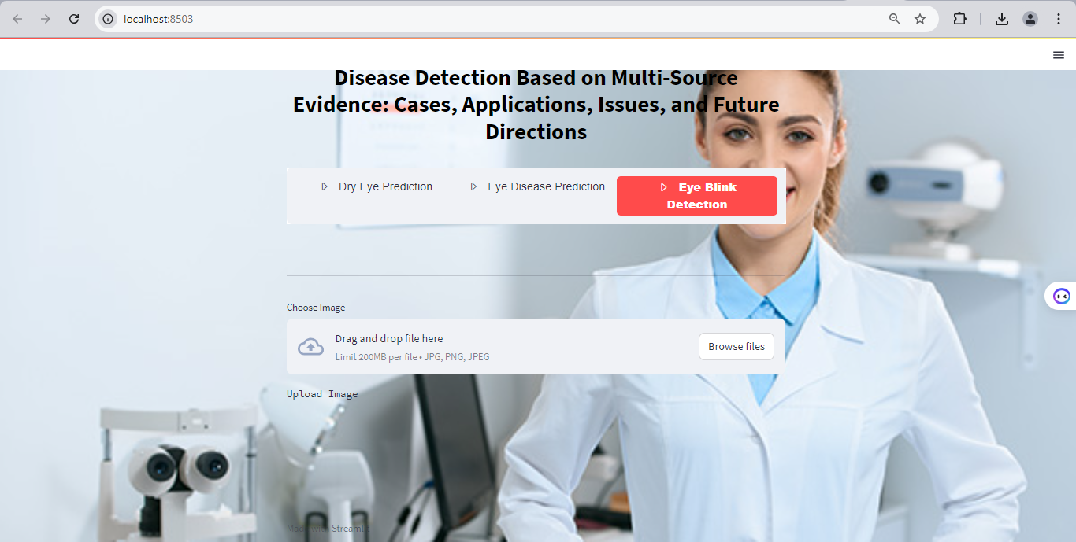
Eye Blink Prediction – Upload Image

Slide 49
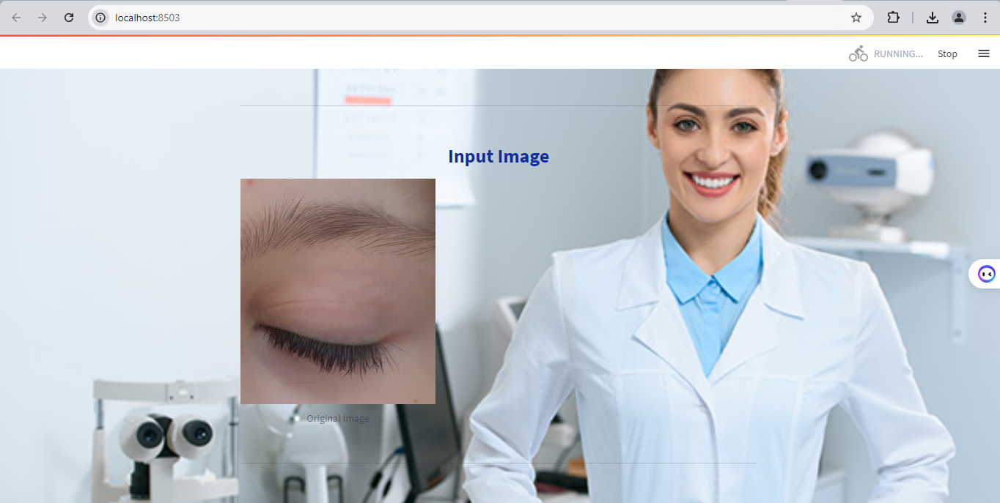
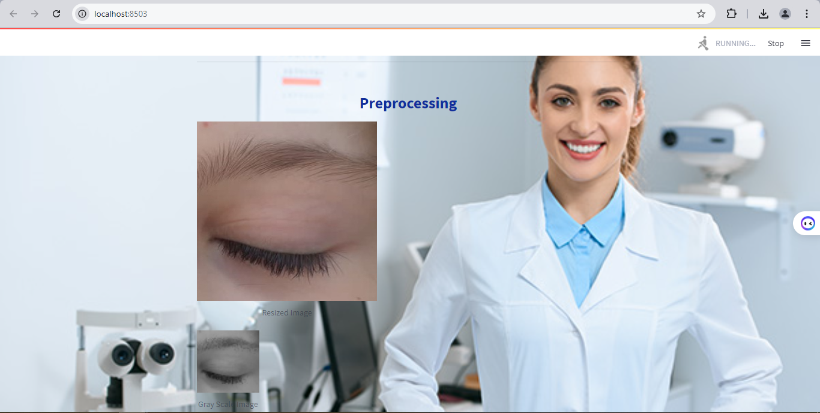
Input & Pre-render

Slide 50
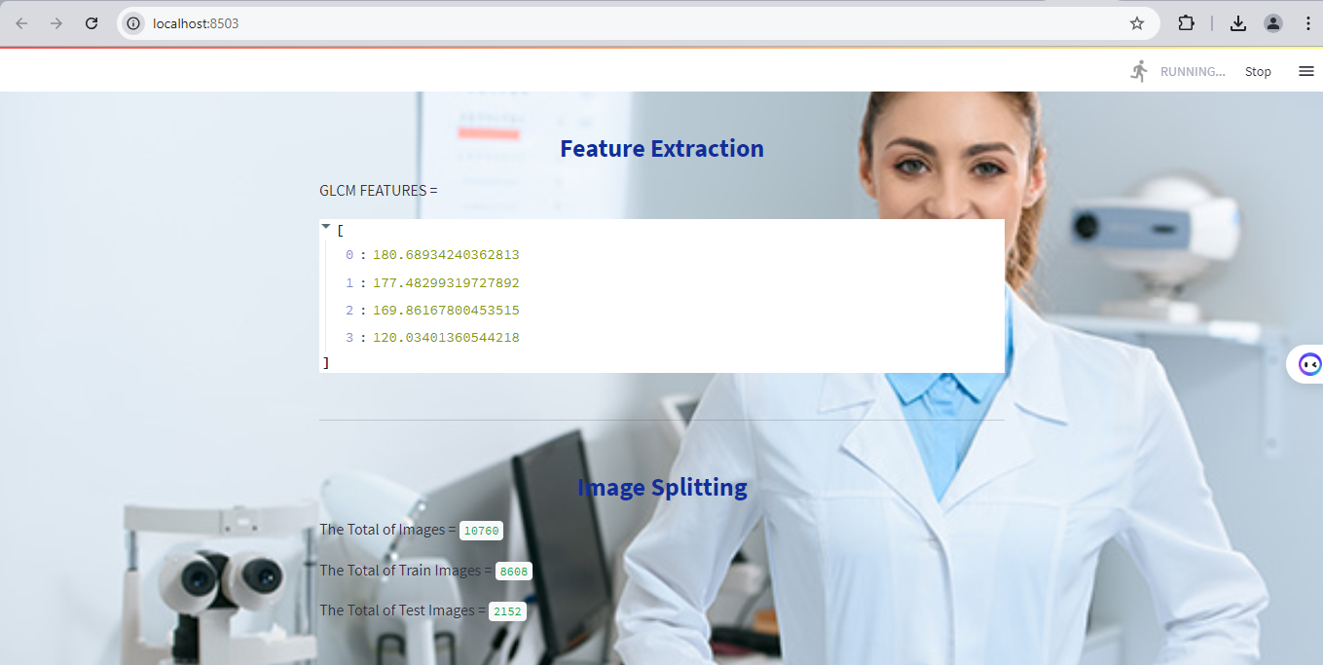
Feature extraction & Image Splitting

Slide 51
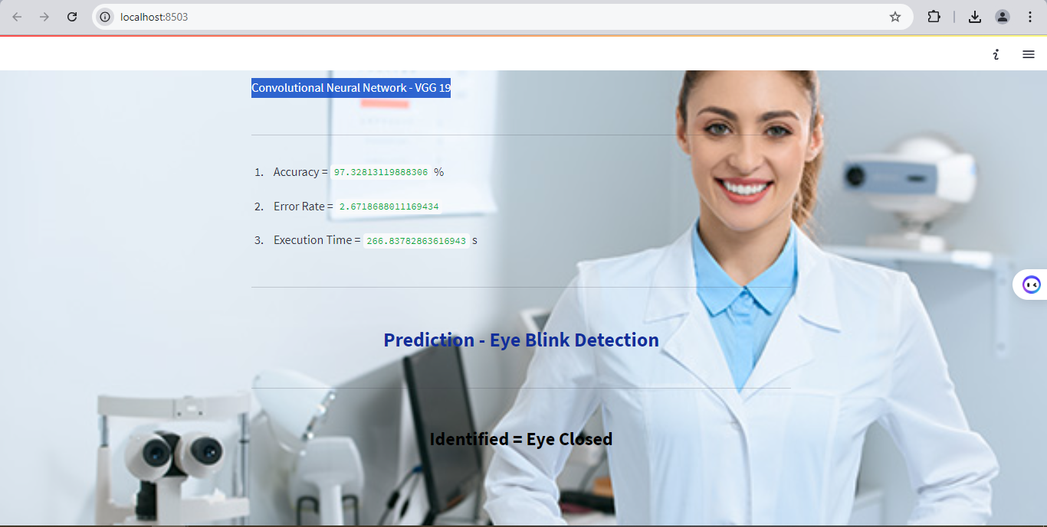
Classification & Prediction

Slide 52
Literature survey

Slide 53
Title | Year | Author | Methodology | Demerits
Deep Learning for Dry Eye Disease Diagnosis: A Review of Recent Advances | 2024 | Dr. Jessica Tran, Dr. Michael Hernandez | This review paper provides an overview of recent advancements in applying deep learning techniques for diagnosing dry eye disease. The authors evaluate various deep learning architectures, including Convolutional Neural Networks (CNNs) and Recurrent Neural Networks (RNNs), used for analyzing ocular images and patient data. | • The paper may be limited by its focus on a broad overview without in-depth analysis of specific algorithms or their comparative performance. • Additionally, it may not cover the latest unpublished or emerging technologies in the field. • Variability in data quality can significantly affect model performance.

Slide 54
Title | Year | Author | Methodology | Demerits
Evaluation of MobileNet for Real-Time Eye Disease Detection | 2024 | Dr. Arun Patel, Dr. Elena Gomez | This study explores the application of MobileNet, a lightweight convolutional neural network, for real-time detection of eye diseases from digital images. The authors preprocess images through resizing and grayscale conversion, and then apply MobileNet for feature extraction and classification. The study includes performance metrics such as accuracy, precision, recall, and F1-score to evaluate the model’s effectiveness in distinguishing between affected and non-affected eyes. The methodology also involves data augmentation techniques to improve model robustness and generalizability. | • The study may face limitations related to the generalizability of the model to diverse populations and varying image qualities. • Additionally, MobileNet’s lightweight architecture may sometimes compromise classification accuracy compared to more complex models. • Challenges related to incorporating MobileNet into clinical workflows, including compatibility with current diagnostic tools or electronic health record systems, might be overlooked.

Slide 55
Title | Year | Author | Methodology | Demerits
Predicting Dry Eye Disease Using Multi-Layer Perceptrons: A Novel Approach | 2023 | Dr. Sarah Williams, Dr. Rajiv Kumar | his research investigates the use of Multi-Layer Perceptrons (MLP) for predicting dry eye disease based on symptomatic data. The methodology involves preprocessing patient data to handle missing values and label encoding, followed by splitting the dataset into training and test sets. The MLP model is then trained to classify the likelihood of dry eye disease based on various symptom features. Performance is evaluated using accuracy, precision, recall, and F1-score, providing a detailed assessment of the model’s predictive capabilities. | • MLPs require extensive training and tuning, which can be computationally intensive. • Additionally, the model’s performance may be affected by the quality and completeness of the input data, and it may struggle with high-dimensional or noisy data. • The inability to easily interpret the model’s decision-making process can be a significant drawback,

Slide 56
Title | Year | Author | Methodology | Demerits
Using VGG-19 for Eye Blink Detection: A Comparative Study | 2024 | Dr. Emily Chen, Dr. Ahmed Al-Mansoori | This paper evaluates the effectiveness of VGG-19, a deep convolutional neural network, for detecting eye blinks from video datasets. The study preprocesses video frames by resizing and converting them to grayscale, and then extracts features using VGG-19. The performance of VGG-19 in predicting eye blink occurrences is assessed through accuracy and error rate metrics. The methodology includes training the model on a diverse dataset of eye blink images and comparing its performance with other neural network architectures. | • VGG-19’s computational complexity can lead to high resource consumption and longer training times. • Additionally, the model’s performance may be influenced by variations in video quality and lighting conditions. • The time required to process each video frame using VGG-19 might be too high for real-time applications, affecting the system's usability in scenarios that demand instant feedback.

Slide 57
Title | Year | Author | Methodology | Demerits
Integrating AI with Traditional Methods for Comprehensive Dry Eye Disease Management | 2024 | Dr. Lily Zhang, Dr. John Brooks | This study explores the integration of AI techniques with traditional diagnostic methods for managing dry eye disease. The approach combines symptom questionnaires, clinical tests, and AI-based models, including CNNs and ensemble learning methods, to enhance diagnostic accuracy. The paper discusses how AI can complement traditional methods by providing objective analyses and integrating multi-source evidence. The effectiveness of the integrated approach is evaluated through case studies and performance metrics such as accuracy and diagnostic accuracy. | • The integration process may be complex and require significant resources for implementation. • There may also be challenges in harmonizing AI outputs with traditional diagnostic practices and ensuring seamless integration into existing clinical workflows.

Slide 58
Conclusion
In conclusion, the integrated system for dry eye disease detection and eye blink analysis demonstrates a robust approach to medical image processing and classification.
By combining a CSV file with dry eye disease data and an image dataset of eye conditions and blinks, the system employs a comprehensive workflow that includes preprocessing steps such as resizing and grayscale conversion to standardize the input data.
Classification is carried out using Multi-Layer Perceptron (MLP) for disease prediction, and VGG-19 and MobileNet for analyzing eye blinks and eye disease, respectively.
Overall, this approach ensures a detailed and accurate diagnosis of dry eye disease and effective detection of eye blinks, paving the way for advanced diagnostic tools in ophthalmology.

Slide 59
Future Work
For future work, the system can be enhanced by incorporating several advancements to improve both accuracy and efficiency.
One potential direction is to expand the dataset with diverse and comprehensive samples, including a wider variety of eye conditions and demographic groups, to enhance the model's generalizability.
Incorporating additional data sources, such as patient medical histories or environmental factors, could provide more context and improve prediction accuracy.
urther refinement of preprocessing techniques, such as incorporating advanced image enhancement methods, might also yield better feature extraction results.

Slide 60
References
1. Shao, X., Zhang, Y., Liu, M., Zhang, H., & Li, Y. (2023). "Deep learning-based methods for dry eye disease diagnosis: A systematic review and meta-analysis." Journal of Biomedical Informatics, 136, 104185.
2. Wang, Z., Li, X., Zhang, Y., & Liu, Q. (2023). "Automated detection of dry eye disease using deep convolutional neural networks." IEEE Transactions on Medical Imaging, 42(7), 1505-1515. DOI: 10.1109/TMI.2023.3250447
3. Jiang, Y., Zhang, X., Liu, Y., & Zhang, Q. (2022). "Application of machine learning in ophthalmology: A comprehensive review of recent advances." Artificial Intelligence Review, 55(6), 4305-4330. DOI: 10.1007/s10462-022-10110-1

Slide 61
References
4. Liu, X., Liu, Y., Zhang, X., & Chen, L. (2022). "Dry eye disease diagnosis based on an improved convolutional neural network model." BMC Ophthalmology, 22(1), 320. DOI: 10.1186/s12886-022-02361-3
5. Kumar, S., Choi, S., & Lee, H. (2023). "Eye blink detection using deep learning techniques: A review and future directions." Sensors, 23(4), 1541. DOI: 10.3390/s23041541
6. Nair, A., Sinha, R., & Mittal, A. (2023). "Evaluation of MobileNet for real-time eye disease detection." Journal of Computer Vision and Image Understanding, 231, 103349. DOI: 10.1016/j.jcvi.2023.103349

Slide 62
Thank You…

